Slide 1
Case Study: Classifying and Analyzing Physical Activities through Heart Rate Variability and Other Physical Metrics Using Holter Monitor Data
Boyan Davidov, Boyan Markov, Simona Mircheva
Notes:
Image by stokpic from Pixabay From <https://pixabay.com/photos/man-jumping-mountains-731900/>

Slide 2
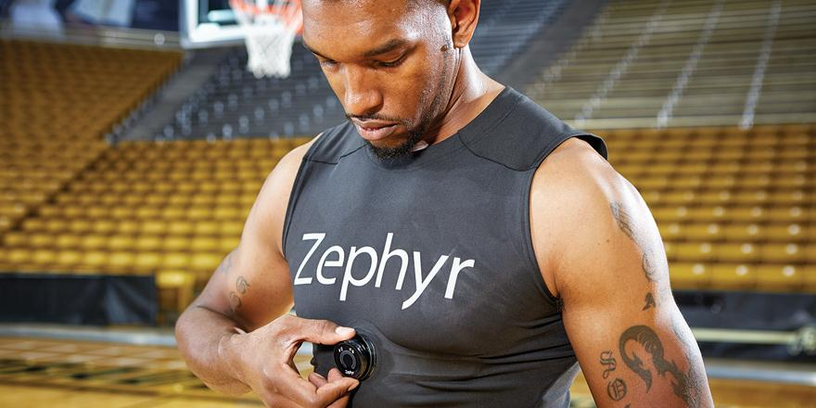

Overview
Zephyr Technology Corporation - BioModule 3.0
Human Activity Recognition
Notes:
Academics and Researchers | Zephyr™ Performance Systems (zephyranywhere.com) Photo from https://www.zephyranywhere.com/

Slide 3
Holter Monitor
Physical metrics like heart rate variability, respiratory rate, oxygen saturation and body temperature
Data points annotated with a corresponding physical activity label like running, walking, swimming, cycling, or resting
Human Activity Recognition
Notes:
Academics and Researchers | Zephyr™ Performance Systems (zephyranywhere.com) Photo from https://www.zephyranywhere.com/

Slide 4
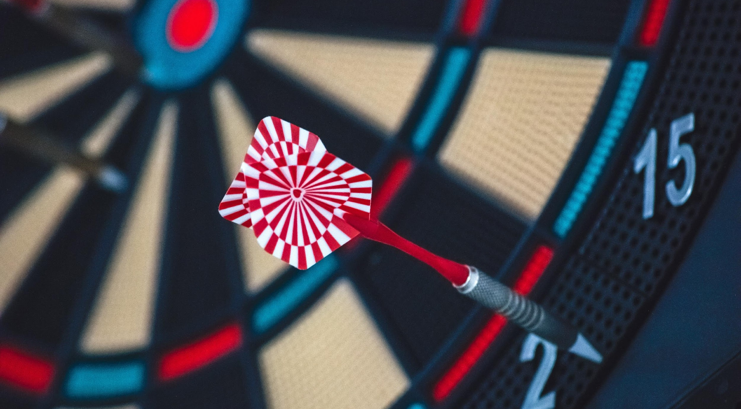
Goals
Identifying similarities among diverse physical activities using the provided metrics.
Constructing a predictive model capable of accurately categorizing the type of activity based on the recorded data.
Human Activity Recognition
Notes:
Photo by Pixabay: https://www.pexels.com/photo/abstract-accuracy-accurate-aim-262438/ From <https://www.pexels.com/photo/abstract-accuracy-accurate-aim-262438/>

Slide 5
Analysis stages
Similarity Analysis
Model Development
Model Evaluation
Human Activity Recognition
Notes:
Photo by Pixabay: https://www.pexels.com/photo/abstract-accuracy-accurate-aim-262438/ From <https://www.pexels.com/photo/abstract-accuracy-accurate-aim-262438/>

Slide 6
Similarity Analysis
In our analysis, we employ clustering techniques such as t-sne or k-means clustering to group physically similar activities based on the recorded metrics.
Human Activity Recognition
Notes:
Photo by Pixabay: https://www.pexels.com/photo/abstract-accuracy-accurate-aim-262438/ From <https://www.pexels.com/photo/abstract-accuracy-accurate-aim-262438/>

Slide 7
Model Development
For the development of our predictive model, we explore various machine learning algorithms. These models undergo rigorous evaluation using methods like cross-validation and hyperparameter tuning to ensure robustness and accuracy.
Human Activity Recognition
Notes:
Photo by Pixabay: https://www.pexels.com/photo/abstract-accuracy-accurate-aim-262438/ From <https://www.pexels.com/photo/abstract-accuracy-accurate-aim-262438/>

Slide 8
Model Evaluation
To gauge the effectiveness of our models in classifying physical activities, we will assess them using performance metrics including precision, recall, F1-score, and accuracy.
Human Activity Recognition
Notes:
Photo by Pixabay: https://www.pexels.com/photo/abstract-accuracy-accurate-aim-262438/ From <https://www.pexels.com/photo/abstract-accuracy-accurate-aim-262438/>

Slide 9

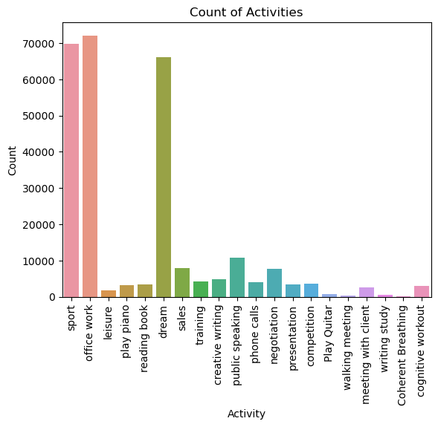
Data Exploration
Labeled data covering 29 physical metrics
Human Activity Recognition
Notes:
Photo by cottonbro studio: https://www.pexels.com/photo/man-with-binary-code-projected-on-his-face-5474028/
From <https://www.pexels.com/photo/man-with-binary-code-projected-on-his-face-5474028/>

Slide 10
Data Exploration
Labeled data covering 29 physical metrics
Severely imbalanced dataset with overrepresented classes
Human Activity Recognition
Notes:
Photo by cottonbro studio: https://www.pexels.com/photo/man-with-binary-code-projected-on-his-face-5474028/
From <https://www.pexels.com/photo/man-with-binary-code-projected-on-his-face-5474028/>

Slide 11
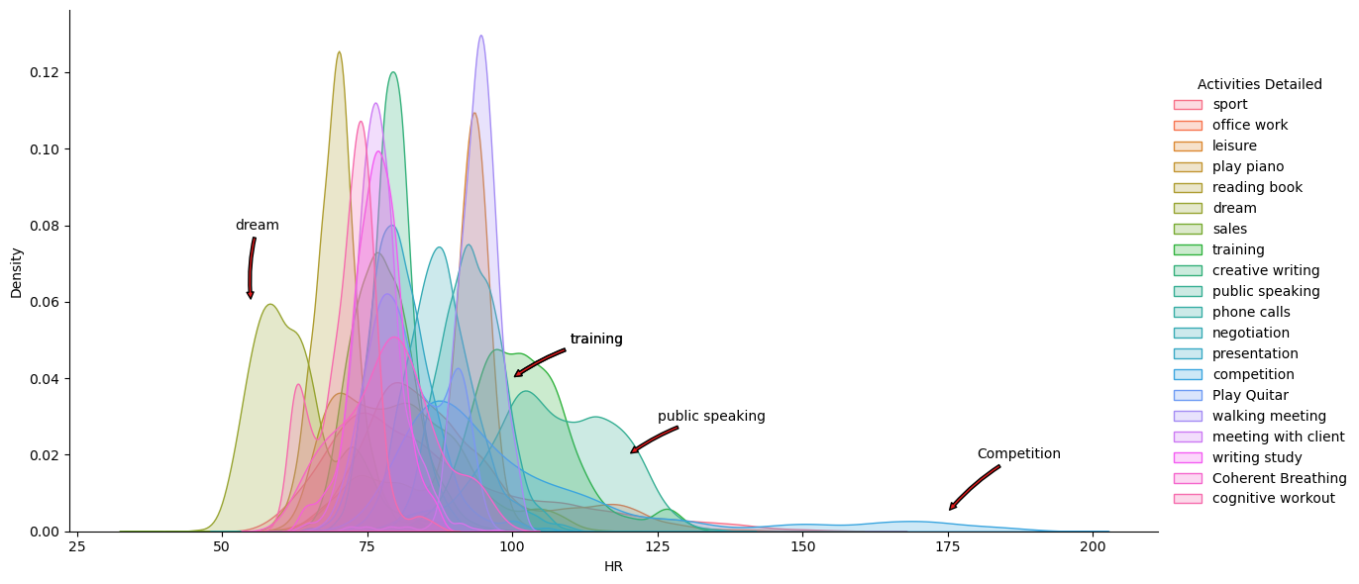
Data Exploration
Noteworthy features among the measured metrics are heart rate (HR) and heart rate variability (HRV), which reflects the variation in time intervals between consecutive heartbeats.
Human Activity Recognition

Slide 12
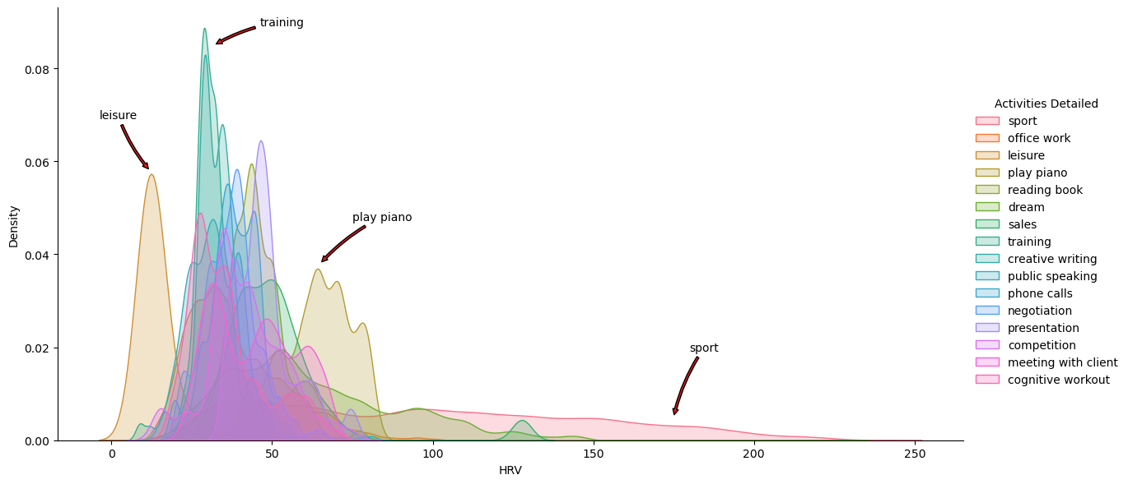
Data Exploration
Noteworthy features among the measured metrics are heart rate (HR) and heart rate variability (HRV), which reflects the variation in time intervals between consecutive heartbeats.
Human Activity Recognition

Slide 13
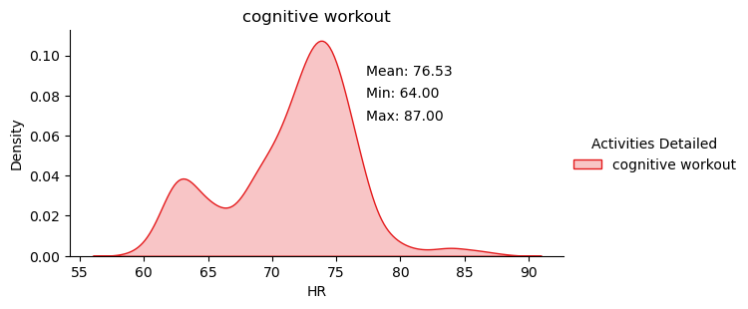
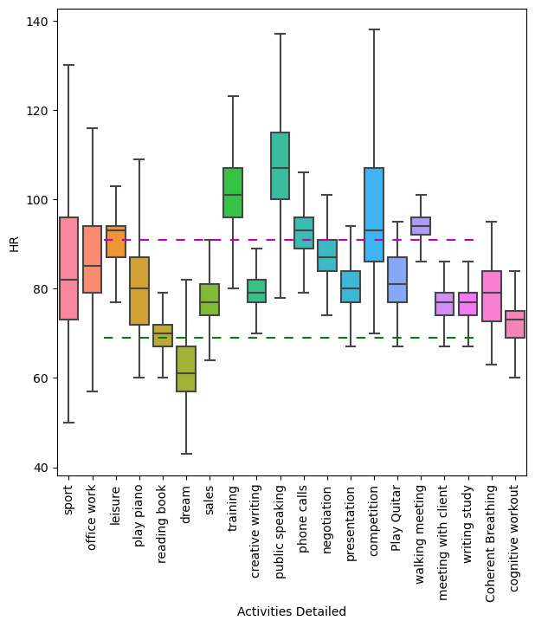
Data Exploration
The features are rarely normally distributed, with many observations in the 3rd quartile.
Human Activity Recognition

Slide 14
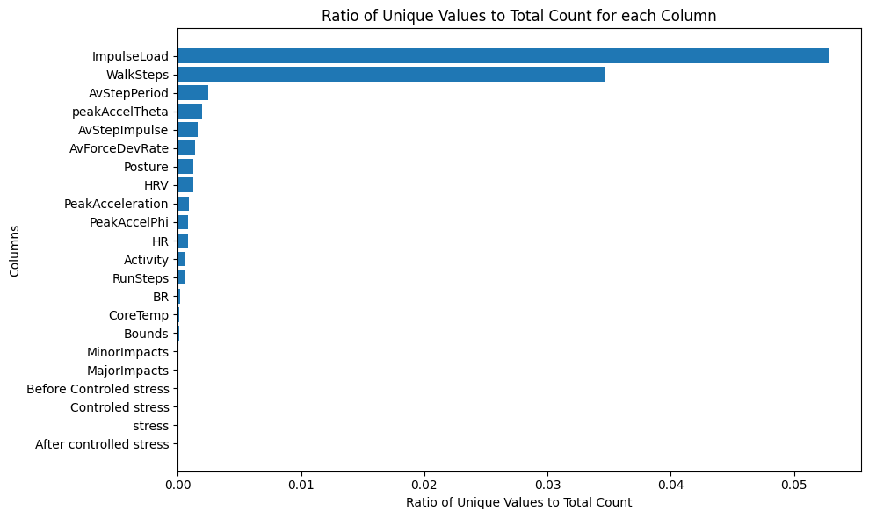
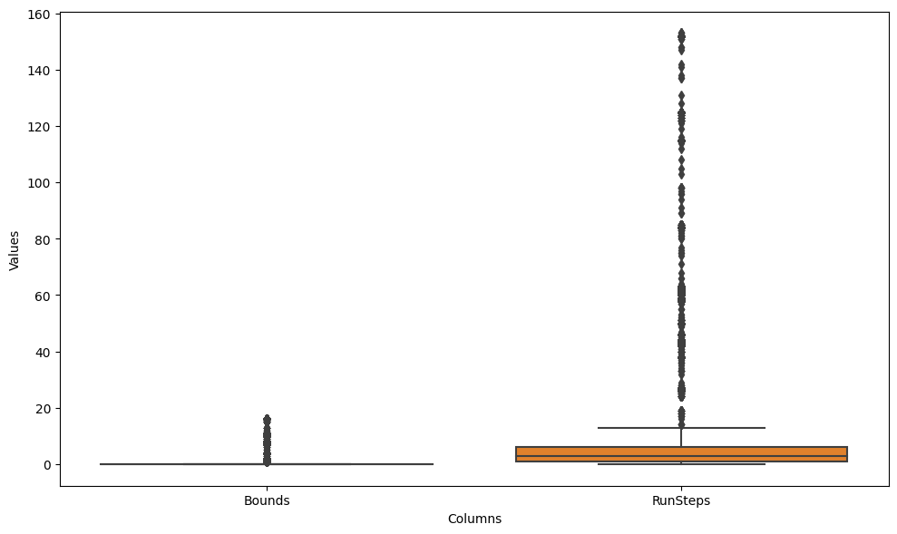
Data Exploration
Distinctiveness of the dataset is relatively low
Some features are quasi binary
Human Activity Recognition

Slide 15
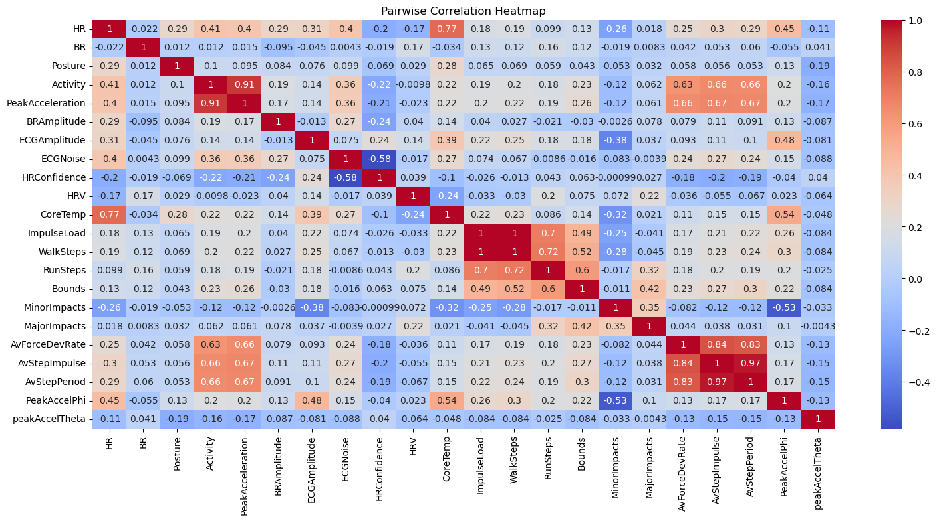
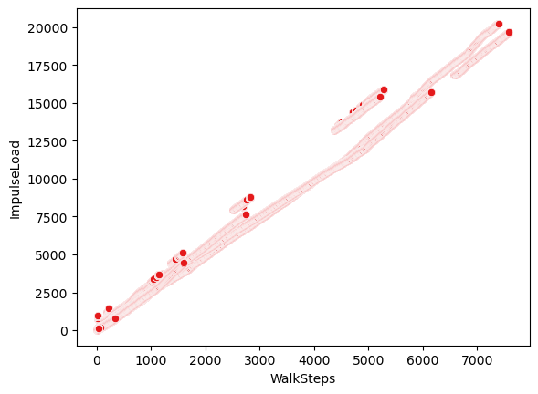
Dimensionality Reduction
Some of the features were highly correlated (linearly), implying redundancy of features
Human Activity Recognition

Slide 16

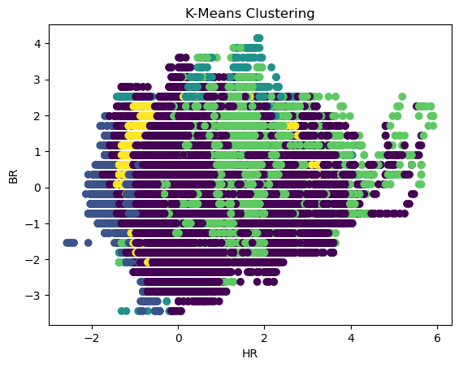
Dimensionality Reduction
We attempted first to reduce dimensionality via PCA, however, to achieve >80% explained variance we needed 8 components
K-means clustering alone was not able to draw clear boundaries
Human Activity Recognition
Notes:
Photo by Tima Miroshnichenko: https://www.pexels.com/photo/a-person-holding-a-smartphone-7567228/
From <https://www.pexels.com/photo/a-person-holding-a-smartphone-7567228/>

Slide 17
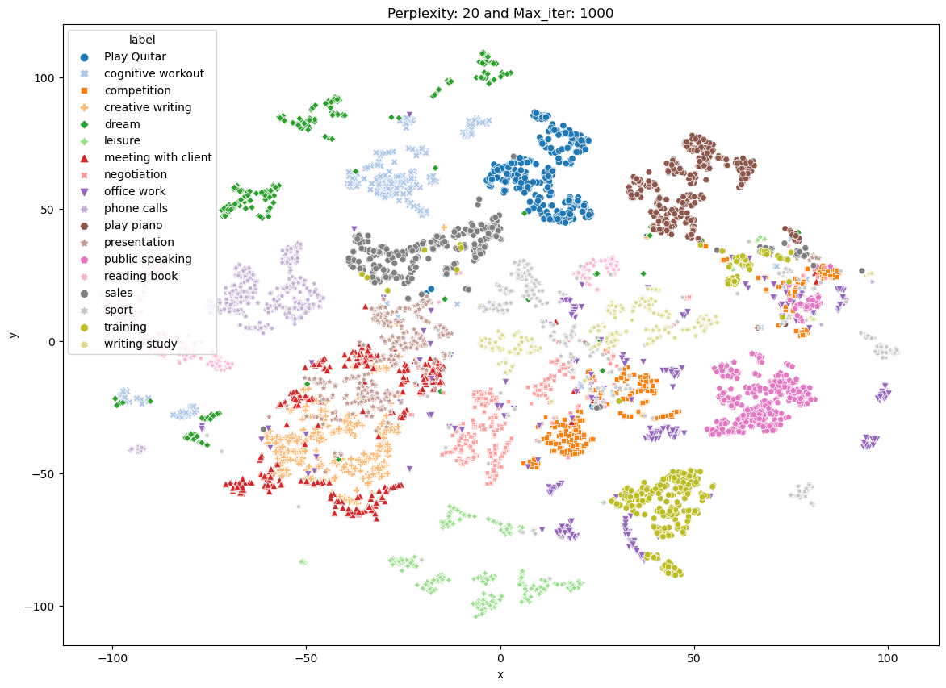
Similarity Analysis
t-SNE (t-distributed stochastic neighbour embedding) was able to separate them nicely although not perfectly
t-SNE is a nonlinear dimensionality reduction technique which retains local variance (PCA → global variance)
Human Activity Recognition
Notes:
Photo by Tima Miroshnichenko: https://www.pexels.com/photo/a-person-holding-a-smartphone-7567228/
From <https://www.pexels.com/photo/a-person-holding-a-smartphone-7567228/>

Slide 18
Similarity Analysis
Certain degree of class mixing might be unavoidable
Shortcoming - t-SNE doesn’t inherently define decision boundaries (i.e. you need to perform additionally some clustering)
Perplexity(P) needs to be defined by the user (the larger the P the more data points are included in the neighbourhood)
Slow…
Human Activity Recognition
Notes:
Photo by Tima Miroshnichenko: https://www.pexels.com/photo/a-person-holding-a-smartphone-7567228/
From <https://www.pexels.com/photo/a-person-holding-a-smartphone-7567228/>

Slide 19
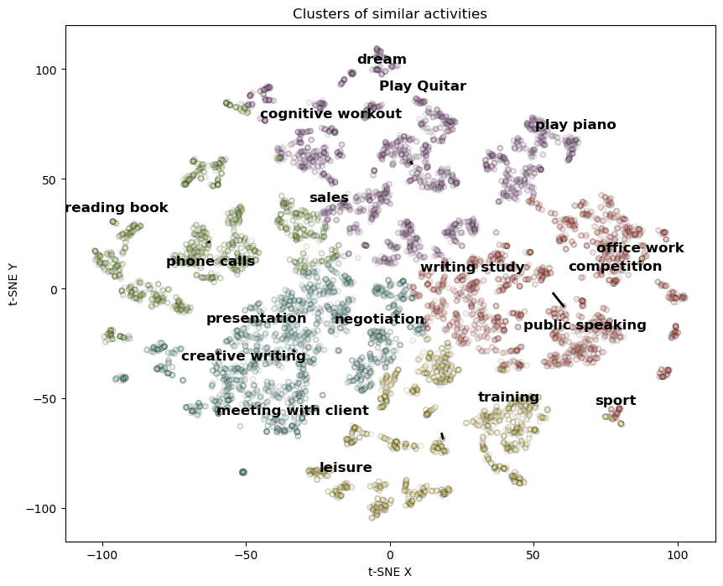
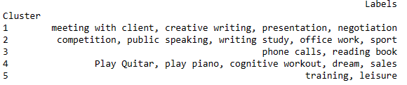
Similarity Analysis
T-SNE
Human Activity Recognition
Notes:
Photo by Tima Miroshnichenko: https://www.pexels.com/photo/a-person-holding-a-smartphone-7567228/
From <https://www.pexels.com/photo/a-person-holding-a-smartphone-7567228/>

Slide 20
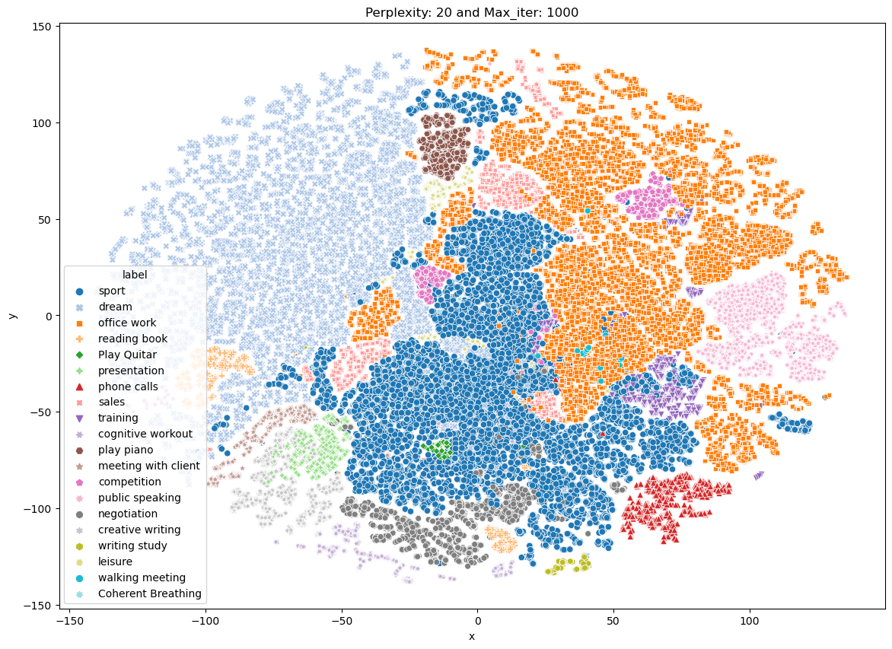
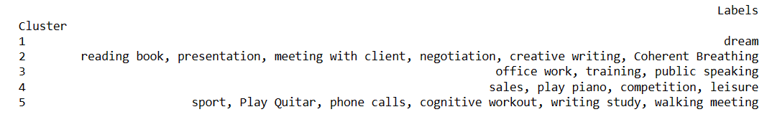
Similarity Analysis
Human Activity Recognition
Notes:
Photo by Tima Miroshnichenko: https://www.pexels.com/photo/a-person-holding-a-smartphone-7567228/
From <https://www.pexels.com/photo/a-person-holding-a-smartphone-7567228/>

Slide 21
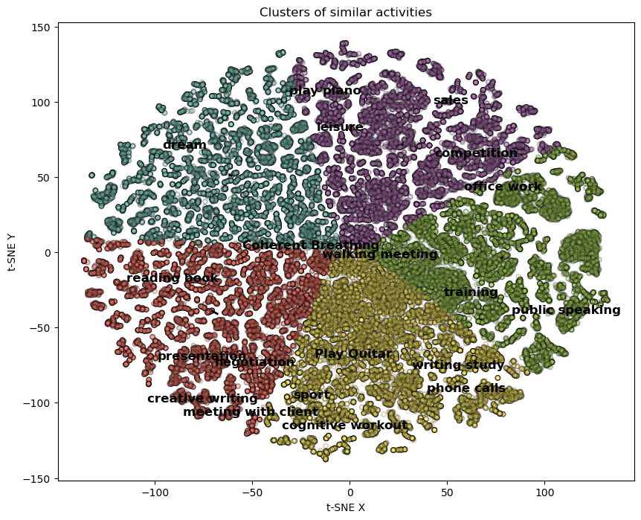
Similarity Analysis
T-SNE
Human Activity Recognition
Notes:
Photo by Tima Miroshnichenko: https://www.pexels.com/photo/a-person-holding-a-smartphone-7567228/
From <https://www.pexels.com/photo/a-person-holding-a-smartphone-7567228/>

Slide 22
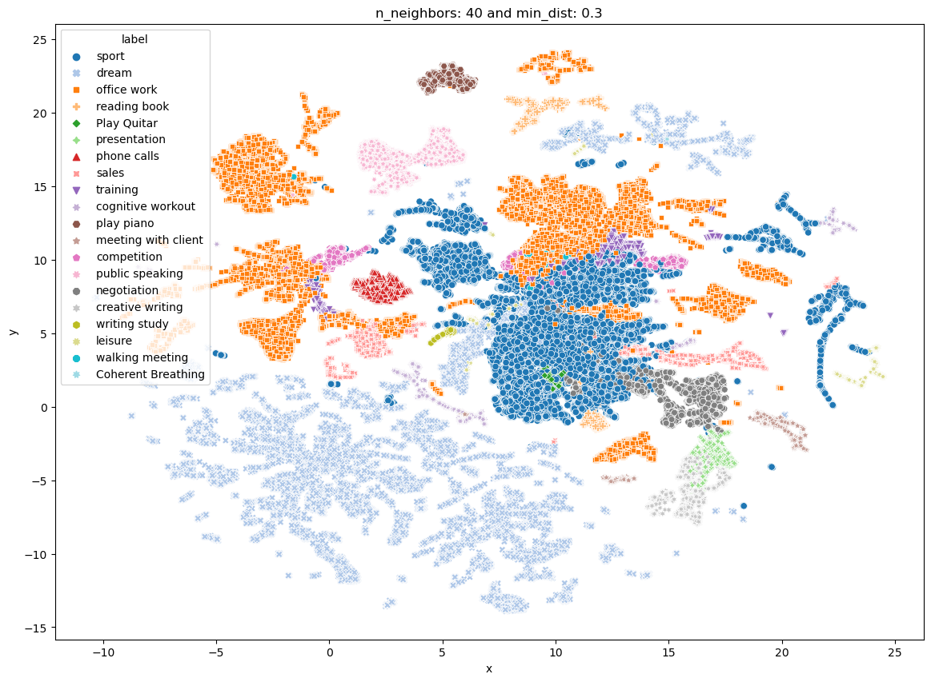
Similarity Analysis
UMAP: (Uniform Manifold Approximation and Projection) is similar to t-SNE but much faster
UMAP constructs a high-dimensional weighted k-neighbour graph representation of the original data X
Human Activity Recognition
Notes:
Photo by Tima Miroshnichenko: https://www.pexels.com/photo/a-person-holding-a-smartphone-7567228/
From <https://www.pexels.com/photo/a-person-holding-a-smartphone-7567228/>

Slide 23
Similarity Analysis
User must choose radius (min_dist) - too small a choice will lead to small, isolated clusters, while too large a choice will connect everything together
Human Activity Recognition
Notes:
Photo by Tima Miroshnichenko: https://www.pexels.com/photo/a-person-holding-a-smartphone-7567228/
From <https://www.pexels.com/photo/a-person-holding-a-smartphone-7567228/>

Slide 24
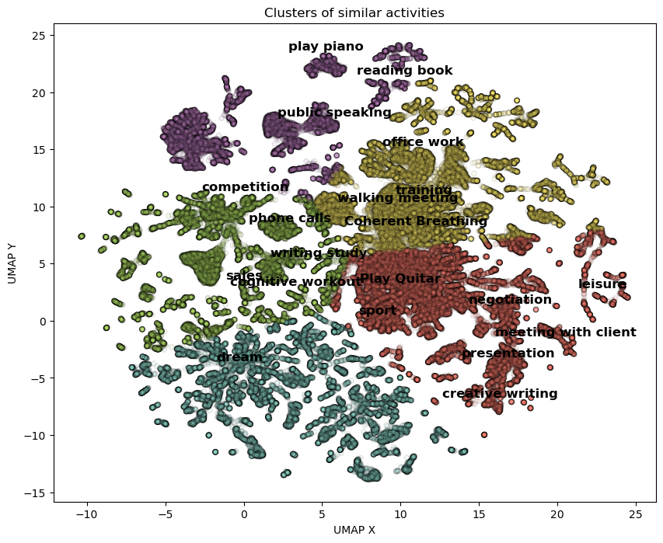
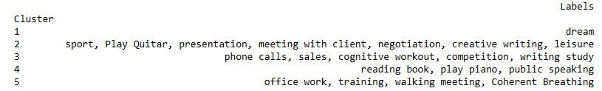
Similarity Analysis
UMAP
Human Activity Recognition
Notes:
Photo by Tima Miroshnichenko: https://www.pexels.com/photo/a-person-holding-a-smartphone-7567228/
From <https://www.pexels.com/photo/a-person-holding-a-smartphone-7567228/>

Slide 25
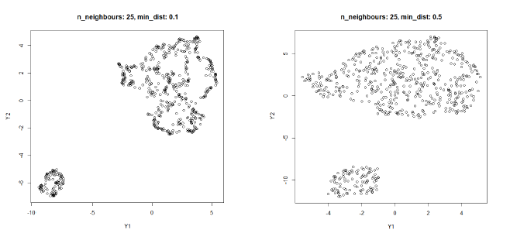
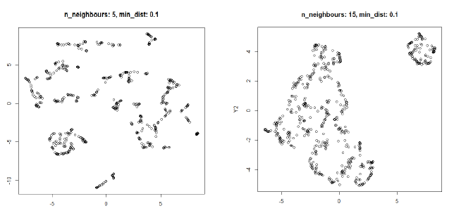
Caveats when using UMAP or t-SNE
Crowding problems
Hyperparameters
Random initialization
Human Activity Recognition
Notes:
Photo by Tima Miroshnichenko: https://www.pexels.com/photo/a-person-holding-a-smartphone-7567228/
From <https://www.pexels.com/photo/a-person-holding-a-smartphone-7567228/>

Slide 26
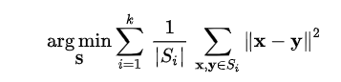
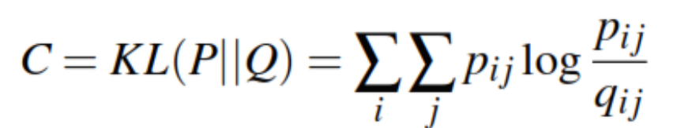
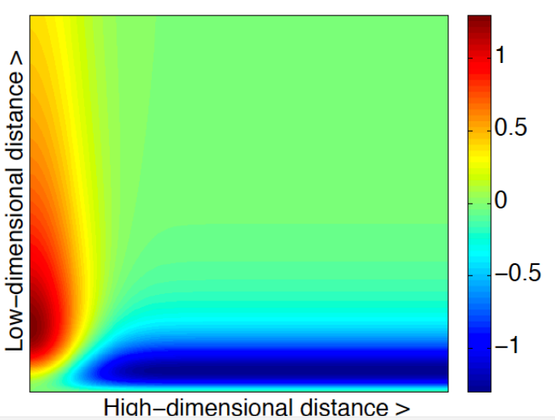
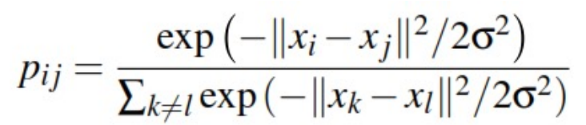
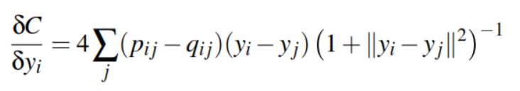
Why does it work
K-means clustering:
How can we measure how close the distributions of X and Y are? -> Kullback–Leibler Divergence
Human Activity Recognition
Gradient descent rationale
Notes:
Photo by Tima Miroshnichenko: https://www.pexels.com/photo/a-person-holding-a-smartphone-7567228/
From <https://www.pexels.com/photo/a-person-holding-a-smartphone-7567228/>

Slide 27
Predictive Model
Human Activity Recognition
Notes:
Photo by Tima Miroshnichenko: https://www.pexels.com/photo/a-person-holding-a-smartphone-7567228/
From <https://www.pexels.com/photo/a-person-holding-a-smartphone-7567228/>

Slide 28
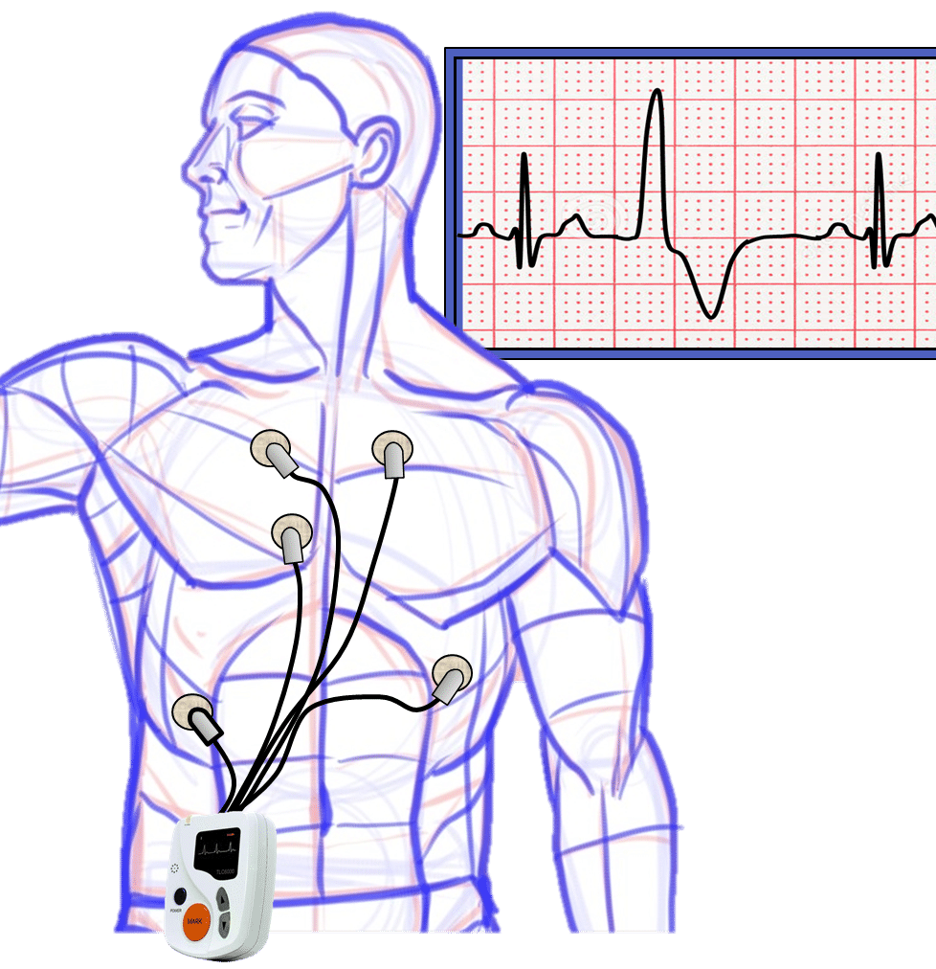
Classifying User Activity via Holter Monitor Data Features
Preliminary Observations:
Distinct clustering patterns within Holter data suggest the feasibility of modeling user activity types.
By harnessing the power of these distinct clustering patterns within Holter data for precise activity classification, we stand at the precipice of a paradigm shift in cardiac health research. This approach not only offers a novel methodology for understanding the intricate relationship between cardiac patterns and physical activity but also sets the stage for a new era of personalized medicine.
Such advancements promise to refine our current knowledge, challenge prevailing notions, and ultimately contribute to the broader scientific discourse on the nexus of physical activity and cardiac health
Human Activity Recognition

Slide 29
Classification of User Activity Types Using Holter Data Features Data Collection and Preprocessing
Model definition
Data Collection
Data Exploration
Use case formulation
Model inception
Human Activity Recognition
Data Split
Outlier Treatment
Data Cleaning
Model
creation
Data Scaler
Model Ensembler
Residuals Analysis

Slide 30
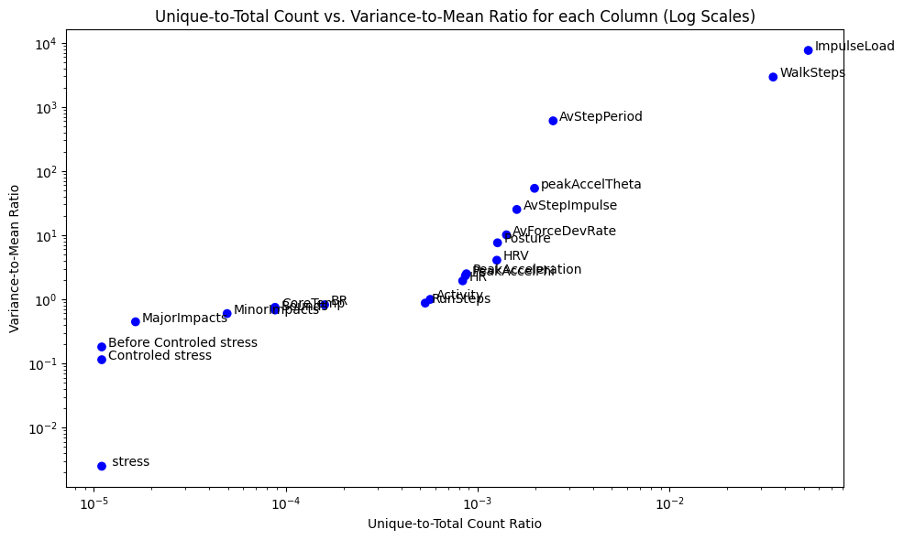

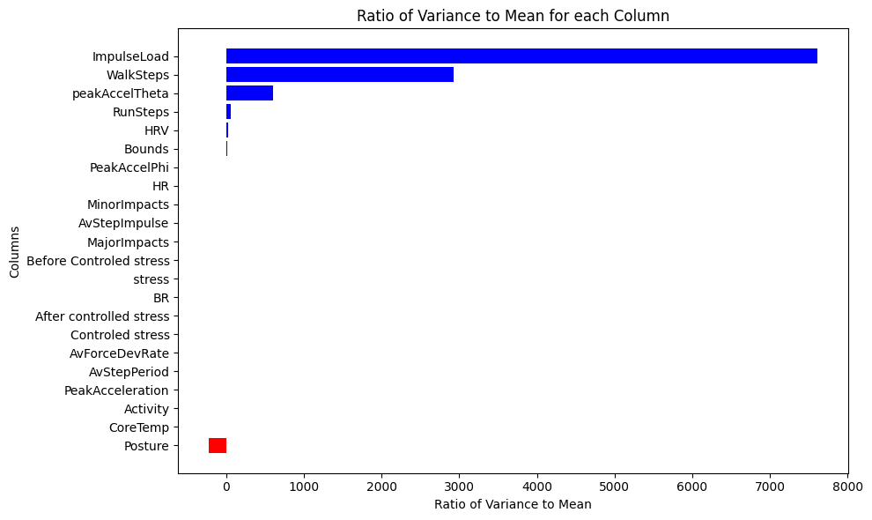
Data Еxploration: Variance in Multiclass Classification
Human Activity Recognition

Slide 31
Data Reduction: A Critical Examination
Temporal Variables (Year, Month, Weekday, Time, Time_New, Date, Hour):
The model exhibited a propensity to overfit based on the temporal sequence of activities (due to low data scale and variability). By removing these variables, we mitigate the risk of the model merely memorizing when specific activities occurred, rather than discerning patterns based on the inherent characteristics of the data.
Holter Machine Health KPIs (BRAmplitude, ECGAmplitude, HRConfidence):
These metrics reflect the operational health and reliability of the Holter machine. They are invariant to the type of activity being performed, making them extraneous for the purpose of activity classification.
Machine Operational Metrics (ECGNoise, Jumps, JumpFlightTime):
These metrics gauge the machine's operational status and its ability to detect noise. Given that the primary objective is to model user activity, these metrics, which pertain more to the machine's functionality, were deemed non-essential.
Manually Inputted Stress Metrics (e.g., Controled stress, stress, etc.):
These metrics, being manually inputted, introduce a subjective element. While they could offer insights into the user's state, their manual nature could introduce variability that might confound the model's predictions. These wouldn’t be available without user input.
Human Activity Recognition

Slide 32
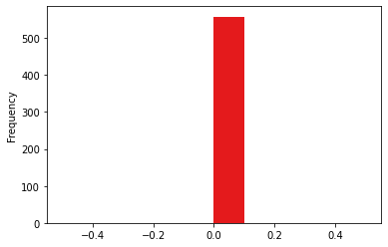

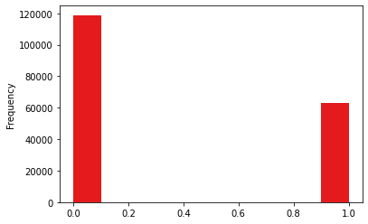
Feature Engineering: Aggregating Sparse Indicators
Objective
Transform columns dominated by zeros, interspersed with sporadic non-zero values, into a streamlined representation.
Approach
Identification: Selected columns with predominantly zero values.
Transformation: Any non-zero entry was marked as 1, encapsulating the presence of activity.
Consolidation: Generated a unified column indicating activity presence across the selected columns.
Optimization: Original columns were discarded, retaining our concise indicator.
Utility
This method offers a distilled view, enabling swift comprehension of activity patterns.
Major / Minor Impacts transformation
Human Activity Recognition

Slide 33
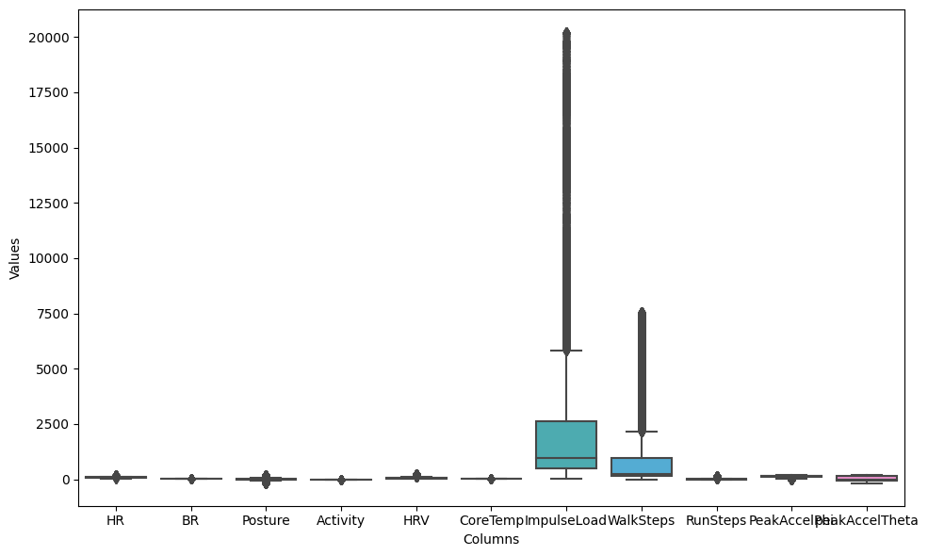
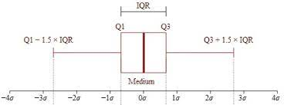
Comprehensive Outlier Reduction Using IQR (numeric)
Methodology
Interquartile Range (IQR) Computation: For each specified column, calculate the 1st (Q1) and 3rd quartiles (Q3). Determine the IQR as the difference between Q3 and Q1.
Outlier Boundaries
Establish boundaries for outliers using the Q1 and Q3
Outlier Detection
Identify data points outside these boundaries as outliers.
Replacement Strategy
Replace detected outliers with the mean of the non-outlier data, augmented with a slight random noise to maintain data variability.
Human Activity Recognition

Slide 34
Ensemble Learning: A Strategic Fusion for Enhanced Predictive Power
Concept
Multiple classifiers harmonize to produce a robust final prediction, leveraging strengths and offsetting weaknesses. Odd count of models to promote adversity.
Voting Classifier with Soft Voting
Aggregates probabilistic predictions for a nuanced decision, rather than a simple majority rule.
Optimization
Utilized RandomizedSearchCV for hyperparameter tuning, ensuring optimal model performance. (performance considerations)
Outcome
Superior Accuracy -The ensemble achieves better accuracy by integrating diverse classifiers, each with its unique decision boundary.
Overfitting Mitigation: Combining models reduces overfitting risks.
Diverse Decision Boundaries - Ensures comprehensive decision-making.
Probabilistic Insight - Soft voting reveals prediction confidence levels.
Human Activity Recognition

Slide 35
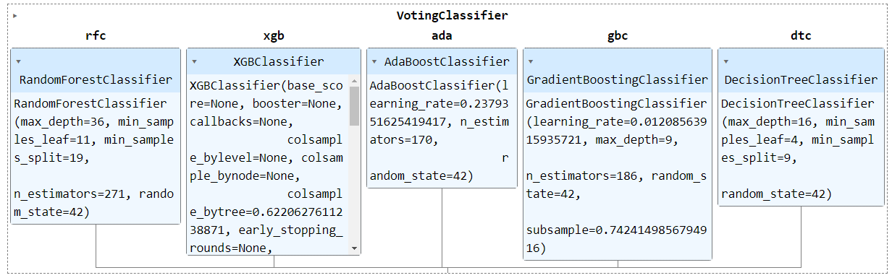
Ensemble Learning: A Strategic Fusion for Enhanced Predictive Power (a lot of trees)
Human Activity Recognition
Classification Label

Slide 36
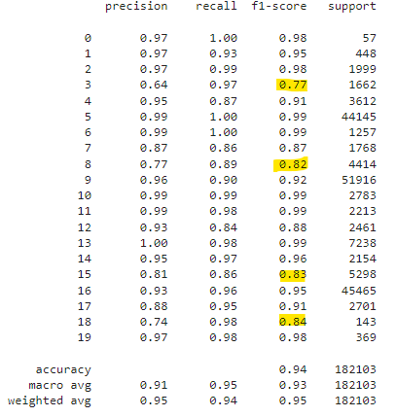
Ensemble Learning: A Strategic Fusion for Enhanced Predictive Power (a lot of trees)
High Accuracy - The model demonstrates an overall accuracy of 94%, indicating a strong ability to correctly classify instances across various classes.
Consistent Precision & Recall - Across the majority of classes, the model showcases high precision and recall rates, suggesting it can reliably identify true positives and minimize false negatives.
Diverse Class Handling - The model effectively handles a wide range of classes, from those with fewer instances to those with tens of thousands, maintaining robust performance metrics.
Challenges with Undersampled Classes - The model's weakest accuracy is observed in classes with fewer samples, highlighting the importance of balanced data for optimal performance. (competition, negotiation, sales, walking meeting)
Macro & Weighted Averages - The macro average, which treats all classes equally, and the weighted average, which considers class imbalances, both reflect high performance, underscoring the model's comprehensive capability.
Takeaway - The ensemble model, optimized using RandomizedSearchCV, demonstrates a well-rounded and reliable classification performance across diverse activity types, with room for improvement in undersampled classes.
Human Activity Recognition

Slide 37
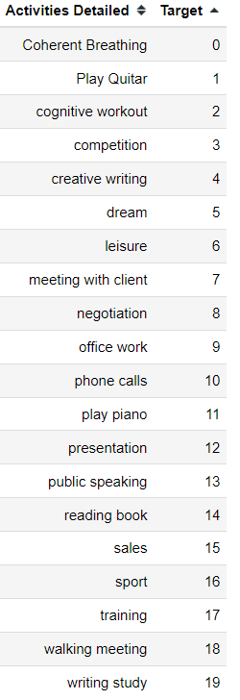
Predictive Labels
Human Activity Recognition
Notes:
Photo by Tima Miroshnichenko: https://www.pexels.com/photo/a-person-holding-a-smartphone-7567228/
From <https://www.pexels.com/photo/a-person-holding-a-smartphone-7567228/>

Slide 38
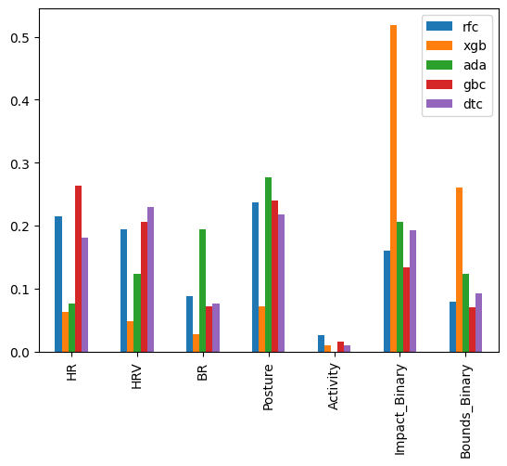
Feature Importances in Ensemble Model
Physiological Metrics Focus: Models like Random Forest and Gradient Boosting place significant emphasis on physiological metrics such as HR and HRV. These features provide a direct insight into the body's response to various activities, making them crucial for accurate activity classification.
Binary Feature Affinity: XGBoost and AdaBoost show a strong inclination towards binary features, especially those like Impact and Bounds. Binary features offer clear decision boundaries, aiding these models in their iterative error correction mechanisms.
Posture & Activity Recognition: Almost all models in the ensemble value the 'Posture' feature. It's a testament to the importance of understanding the user's position in activity classification.
The ensemble approach ensures a harmonious blend of models, each with its unique feature preference. This diversity guarantees that a wide array of features is considered, leading to a comprehensive and robust classification system. By leveraging the strengths of individual models and their feature affinities, we achieve a balanced and well-rounded predictive capability.
Human Activity Recognition

Slide 39
Journey Through Holter Data Insights
1. Data Grouping & Clustering Analysis:
Through rigorous analysis of Holter data, we identified distinct clusters that signify different user activities. This segmentation provided a foundational understanding, setting the stage for predictive modeling.
2. Model Development:
Utilizing a combination of advanced machine learning algorithms, we developed an ensemble model. This approach leverages the strengths of individual classifiers to achieve high predictive accuracy for activity classification.
3. Implications for Holter Devices:
The ability to predict user activities extends the utility of Holter monitors beyond cardiac assessments. It paves the way for comprehensive health monitoring, correlating cardiac data with specific user activities for more nuanced health insights.
4. Future Directions:
While our current model offers promising results, there's potential for further refinement. Future endeavors include integrating real-time AI analytics, enhancing feedback mechanisms, and exploring applications in personalized healthcare solutions.
Human Activity Recognition

Slide 40




THANK YOU!
Contact Details
simona.mircheva@gmail.com b.r.markov@gmail.com
Boyan Davidov
Notes:
https://github.com/a1441/Summer_School_2023/tree/main
GitHub icon by Icons8 <a target="_blank" href="https://icons8.com/icon/4Z2nCrz5iPY2/github">GitHub</a> icon by <a target="_blank" href="https://icons8.com">Icons8</a>
LinkedIn icon by Icons8 <a target="_blank" href="https://icons8.com/icon/8808/linkedin">LinkedIn</a> icon by <a target="_blank" href="https://icons8.com">Icons8</a>

